Slide 1

Sports Analytics III
Produced by Dr. Mario
UNC STOR 390

Slide 2
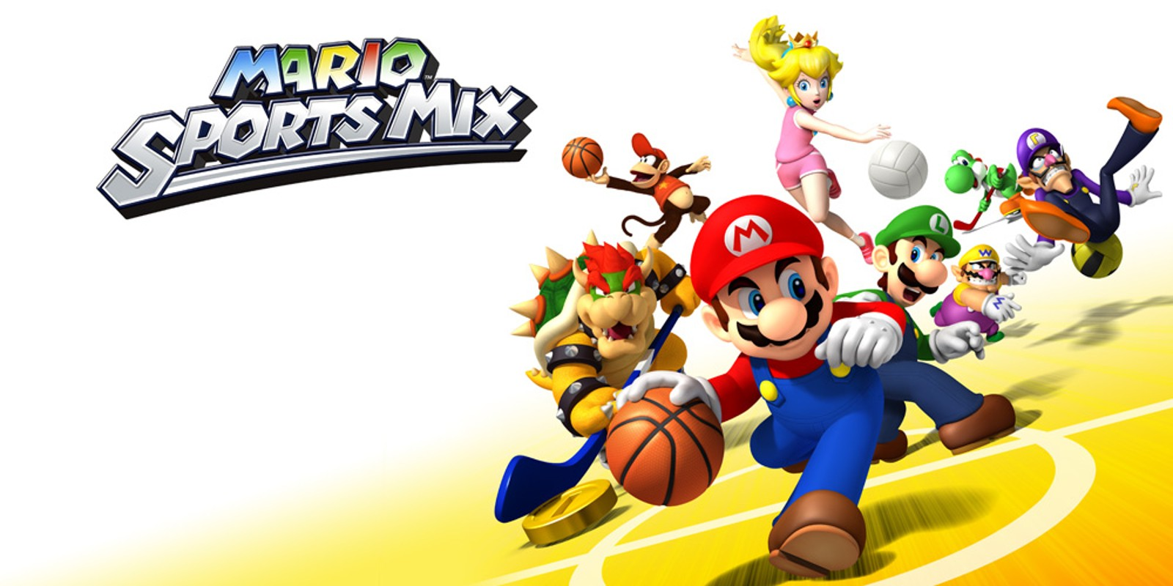
Industry Past
Sports Analytics Use Survey (2013)
Sample of 27 People (NFL, MLB, NBA, EPL)
How Many Different Sources?
1-2 (6.7%)
3-4 (33.3%)
5-6 (13.3%)
>6 (46.71%)

Slide 3
Industry Past
How Much Data is Centralized?
All (31.3%)
Most (37.4%)
Some (31.3%)
How Much Data is Dependent on One Person?
Some (50.0%)
Most (43.7%)
All Data Centralized (6.3%)

Slide 4
Industry Past
Is Data Checked for Errors?
Always (31.3%)
Usually (37.5%)
Sometimes (18.8%)
Occasionally (6.1%)
Rarely (6.3%)
How Many Database Programmers are Employed?
0 (37.5%)
1-2 (50.0%)
3-4 (0.0%)
>5 (12.5%)

Slide 5
Industry Past
How Many Statistical Analysts are Employed?
0 (20.0%)
1-2 (66.6%)
3-4 (0.0%)
>5 (13.3%)
Roadblock: Difficulty Identifying Strong Applicant
Difficulty in Both Hiring and Evaluating

Slide 6
Industry Past
Clear Process for Hiring/Evaluating Analysts
Strongly Agree (13.3%/14.3%)
Somewhat Agree (13.3%/14.3%)
Neutral (26.7%/28.6%)
Somewhat Disagree (13.4%/21.4%)
Strongly Disagree (33.3%/21.4%)
Analytic Resources in Line with Strategic Game Plan
Strongly Agree (26.7%)
Somewhat Agree (33.3%)
Neutral (33.3%)
Strongly Disagree (6.7%)

Slide 7
Industry Past
Clear Process for Hiring/Evaluating Analysts
Strongly Agree (13.3%/14.3%)
Somewhat Agree (13.3%/14.3%)
Neutral (26.7%/28.6%)
Somewhat Disagree (13.4%/21.4%)
Strongly Disagree (33.3%/21.4%)
Analytic Resources in Line with Strategic Game Plan
Strongly Agree (26.7%)
Somewhat Agree (33.3%)
Neutral (33.3%)
Strongly Disagree (6.7%)

Slide 8
Industry Present
Article by Russell Karp (ITProPortal.com)
Global Sports Market Worth $600B-$700B (KPMG)
Including All Business Dedicated to Sports $1.3T
Investment in Data Services
$764.3M
$4B
$125M
2014
2016
2022
Projections in 2022 According to MarketWatch.com

Slide 9
Industry Present
Modern Applications of Sports Analytics
Helping the Team Win
Automated Video Analysis (Lincoln City, UK Football)
3D Depth Camera (NBA)
Wearable Technology (NBA, NHL)
Improving the Fan Experience
Analysis of Digital Engagement
Sentiment in Social Media
Analysis of Fan Behavior in Stadium (New England Patriots)
Wireless Internet and Phone Apps
Apps Supply Game Analytics, Parking Information, Promotions, and Traffic Information to the Fans (NFL)

Slide 10
Industry Present
Modern Applications of Sports Analytics
Benefiting Other Stakeholders
Tracking Fan Behavior Outside the Stadium
Telecommunication, Retailers, Payment Providers, Ticket Agencies, and Sponsorships
Adapt to Quick Changes in Consumer Behavior
Optimizing the Back-Office
HR Practices
Game Scheduling
Supply Chain Management and Logistics
Marketing and Promotions
Procurement of Goods and Services

Slide 11
Industry Present
Modern Applications of Sports Analytics
Advancing Sports Gambling
Supreme Court Ruling Previous Statute Violated 10th Amendment (Murphy v. National Collegiate Athletic Association)
States Free to Legislate Gambling
Improvement of Gambling Products
Data Aggregation and Visualization for Bettors
Develop Daily Fantasy Sports
Worth Over $5B According to Nevada Gaming Control Board (NGCB)

Slide 12
Your Industry Future
Prerequisites by Howard Hamilton
(Soccermetrics)
Technical Skills
Mathematics (Linear Algebra/Probability Essential)
Statistics (Frequentist and Bayesian Perspectives)
Machine Learning (Supervised and Unsupervised)
Programming (R/Python, Data Structures, OOP)
Databases
Visualization
Socials Skills, Ethics, and the Law
Knowledgeable About All Aspects of the Sport

Slide 13
Your Industry Future
Real Jobs (Indeed)
Senior Data Engineer for Event Dynamic
Automated Ticket Pricing System
Bachelors/Masters Quantitative Field
Software Development (2 Years) and Python (1 Year)
Data Scientist for Legends
Consulting for Professional and Collegiate Teams
Design and Supervision of Predictive Models
Bachelors Degree in Quantitative Field
Programming, Data Mining, Statistical Modeling (5 years)
SQL and R (>5 years)
$100K - $500K

Slide 14
Your Industry Future
Real Jobs (Indeed)
Quantitative Analyst for the Philadelphia Eagles
Front Office Applications
Player Development, Game Prep, Resource Allocation
Statistics, Machine Learning, Econometrics
Data Scientist for Zelus Analytics
Help Professional Teams Win Championships
Develop, Validate, and Automate Models
Attend Conferences and Review Research
Bachelors in Quantitative Field
R/Python/SQL
$80K - $110K

Slide 15
Your Industry Future
Real Jobs (Indeed)
Data Scientist for the NBA
Referee Decision Making, Rule Changes, and Game Play
Exploratory Analyses of New Data Sources
Presentation and Communication of Statistical Findings
R/Python/Regression/Machine Learning
Data Visualization Software Like Shiny/Tableau
Bachelors in Quantitative Discipline Required
Sports Research Manager for Turnkey Intelligence
Manage Teams of Data Collectors for Consulting Projects
Leadership Skills
R/SAS Experience is a Plus

Slide 16
Your Industry Future
Real Jobs (Indeed)
Business Analytics Data Scientist for Carolina Panthers
Lead Data Science Initiatives and Marketing Strategy
Analytic Projects Using Python/SQL/Visualization
Bachelors Degree and 5 Years Experience
Masters Degree in Statistics or Economics Preferred
Data Engineer for Disney Streaming Services
Includes ESPN+, MLB.TV, and NHL.TV
Collect, Analyze, and Distribute Data for Transparency
Data Inventory and Data Cleaning
Python (2 to 3 Years)/Spark/Cloud-hosted Databases

Slide 17
Your Industry Future
Real Jobs (Indeed)
Business Analytics Intern for Arizona Coyotes
Assist Analytics Team with Statistical Projects
Upper Level Undergrad or Graduate Student
R/Python/SQL/Tableau/Microsoft Dynamics
Research Analyst for Bleacher Report
Analyze Ad Effectiveness
Mine, Analyze, and Deliver Insights from Campaigns
Quantitative/Qualitative Research Experience (1-2 Years)
R/Tableau/SPSS/SQL
Analytical, Editorial, Communication skills

Slide 18
Your Industry Future
Real Jobs (Indeed)
Sports Data Scientist for Awesomo.com
Track Performance of Models for Fantasy Sports
Development of New Fantasy Sports Products
Develop New Statistics to Predict Performance
Excel and Linear Regressions
$50K-$100K
Senior Manager in Data Science for FanDuel
Coach Team of Data Scientists for Company Projects
Masters/PhD in Quantitative Field
Machine Learning/Bayesian Statistics/Time Series Methods
Python/SQL/AWS/GitHub
Data Science Team (5 Years)

Slide 19
Your Industry Future
Conferences
September
Football Analytics and Performance Summit in Vienna
RIT Sports Analytics Conference in Rochester, NY
New England Symposium on Statistics in Sports in Cambridge, MA
October
Great Lakes Analytics Conference in Stevens Point, WI
Texas Sports Analytics Conference in Dallas
UConn Sports Analytics Conference in Storrs, CT
Japan Sports Analytics Conference in Tokyo
Compiled by statsheetstuffers.com and sportsanalyticsconferences.com

Slide 20
Your Industry Future
Conferences
November
Carnegie Mellon Sports Analytics Conference in Pittsburgh, PA
Ottawa Hockey Analytics at Carleton in Ottawa
Midwest Sports Analytics Meeting in Pelle, IA
United Kingdom Sports Analytics Conference in London
December
Midwest Sports Biometrics Conference in San Francisco,CA
March
MIT Sloan Sports Analytics Conference in Boston, MA
Compiled by statsheetstuffers.com and sportsanalyticsconferences.com

Slide 21
Final Inspiration
Always Be Scoring.
- Mike Giannetto

